Slide 1
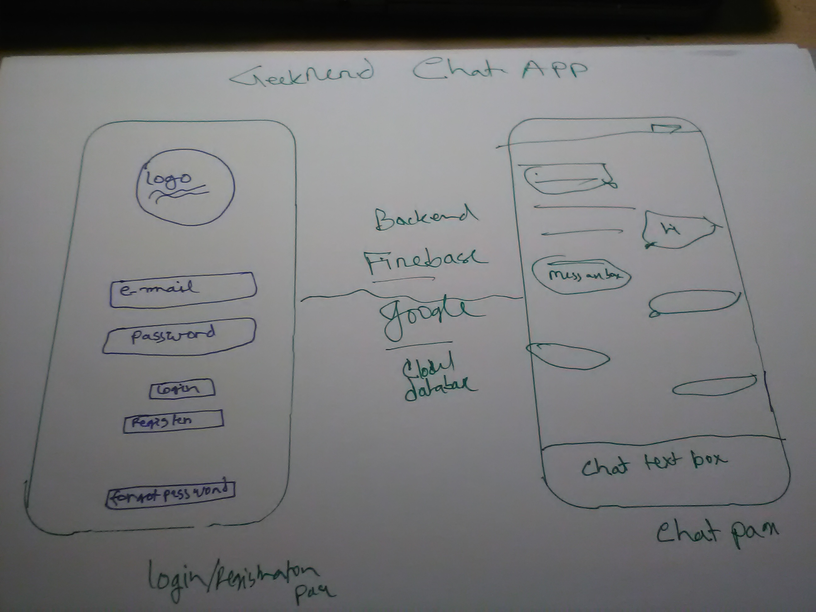

Slide 2
Need
Java (Android)
Swift (iOS)
Firebase (Social log in and backend noSQL database)

Slide 3
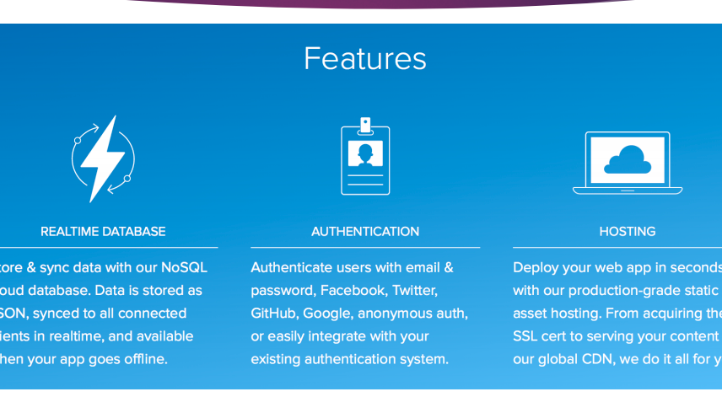
Firebase

Slide 4
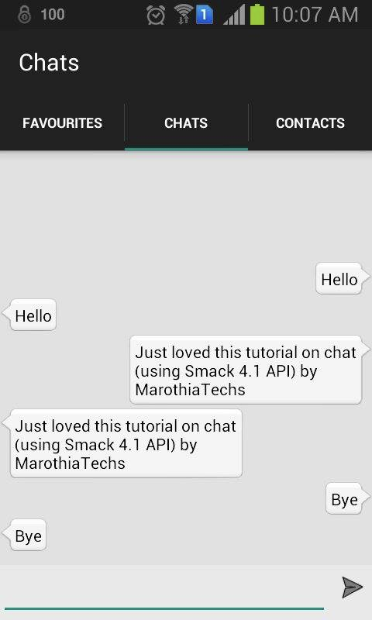
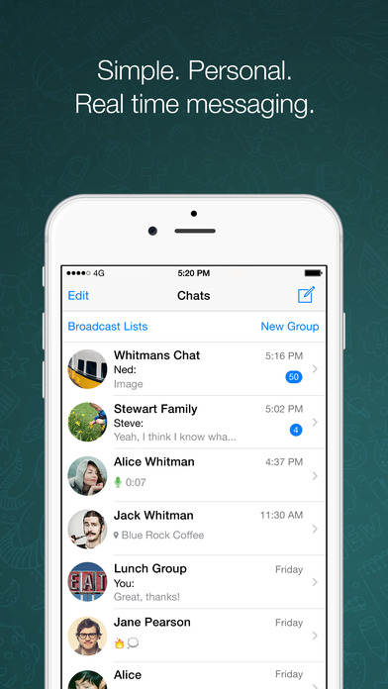
Targeted Chatting App/whats app

Slide 5
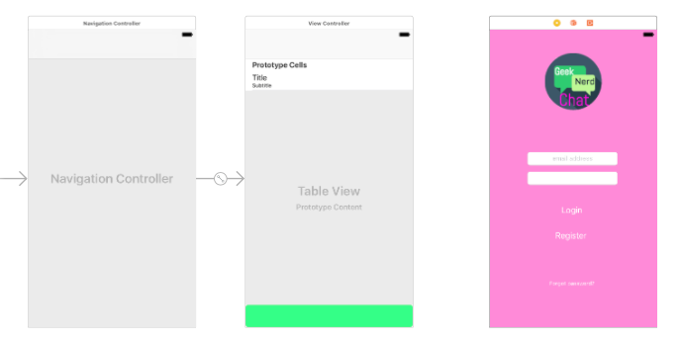
Ongoing: iOS

